Slide 1





LINUX BASED MAIL SERVER

Slide 2
Table of contents
Objective
Architecture/ Flow chart
Hardware/Software requirements
Implementation- Code snippet
Results- Screen Shots of Output
Conclusion

Slide 3



1. OBJECTIVE

Slide 4
OBJECTIVE
The objective of the project is to create a command-line email system for Linux, is to enable users to send and receive emails via the Linux terminal, It aims to facilitate email automation, scripting, and customization while serving as an educational tool for understanding email protocols, and Linux command-line tools. Security, privacy, compatibility, and clear documentation are paramount, ensuring user safety, versatility across Linux distributions and email servers, and ease of use while maintaining the project's educational and functional value.

Slide 5
2. ARCHITECTURE/ FLOWCHART

Slide 6
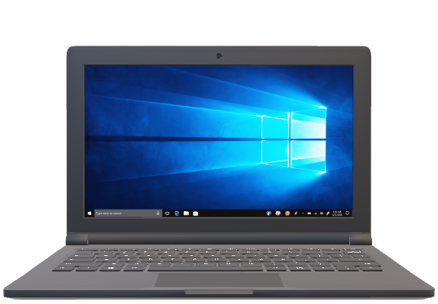


Mail Delivery Agent
Mail Transfer Agent
Database
Sender
Reciver

Slide 7
3. HARDWARE REQUIREMENTS\ SOFTWARE REQUIREMENTS

Slide 8




HARDWARE REQUIREMENTS:
CPU: 1.0 GHz or faster multi-core processor.
RAM: 2 GB (recommended: 4 GB).
Hard Disk Space: 20 GB of disk space (recommended: 40 GB).
SOFTWARE REQUIREMENTS:
1
2
3
4
Red Hat Linux
Postfix Server
Dovecot
PHP

Slide 9
4. CODE SNIPPETS (COMMANDS)

Slide 10
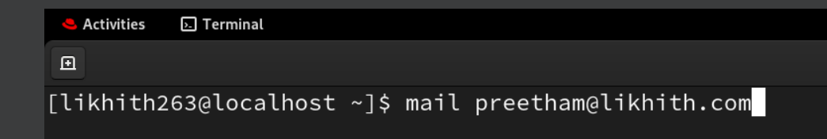
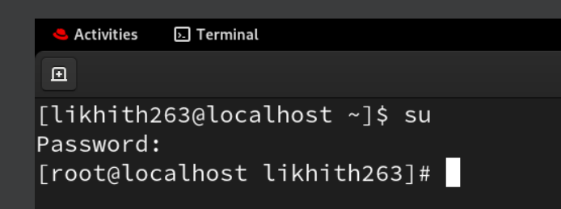
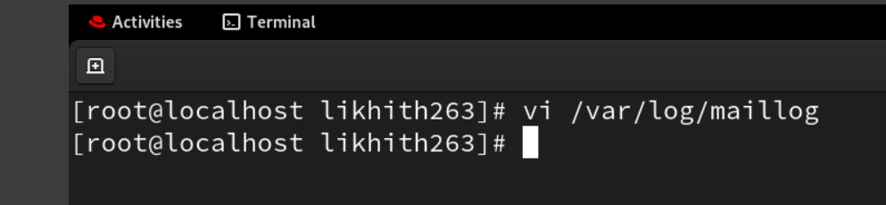
To Send Mail
To Enter Into Root
To open Maillog

Slide 11
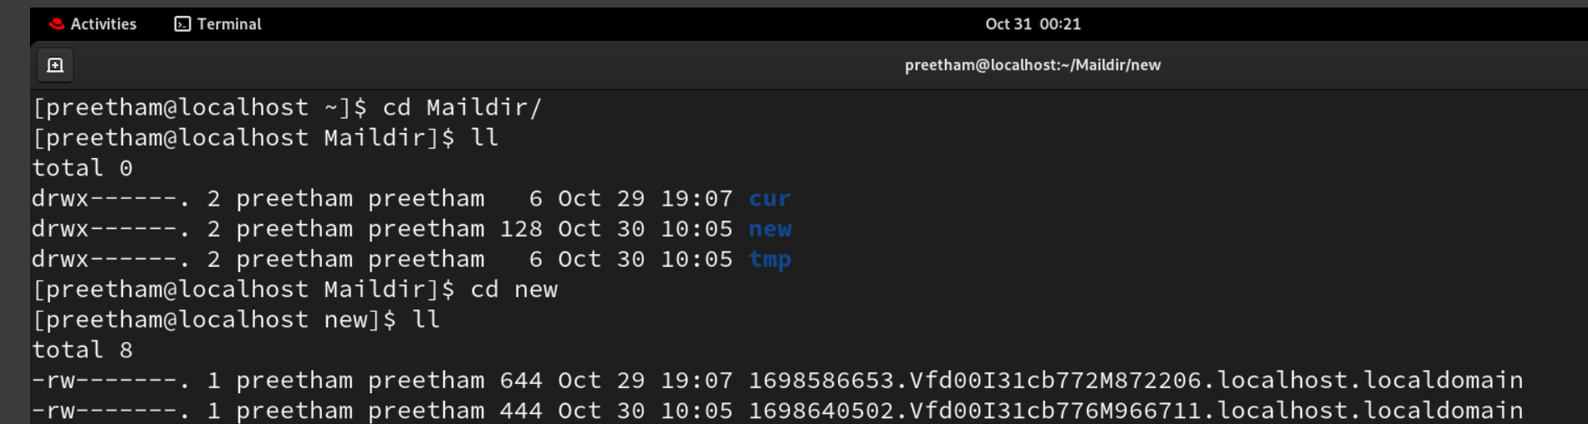
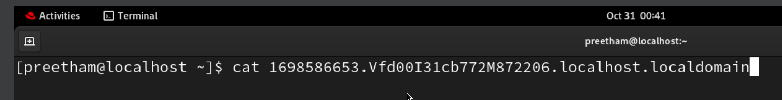
To Open Mail Directory
To View message

Slide 12
5. OUTPUT (RESULT)

Slide 13
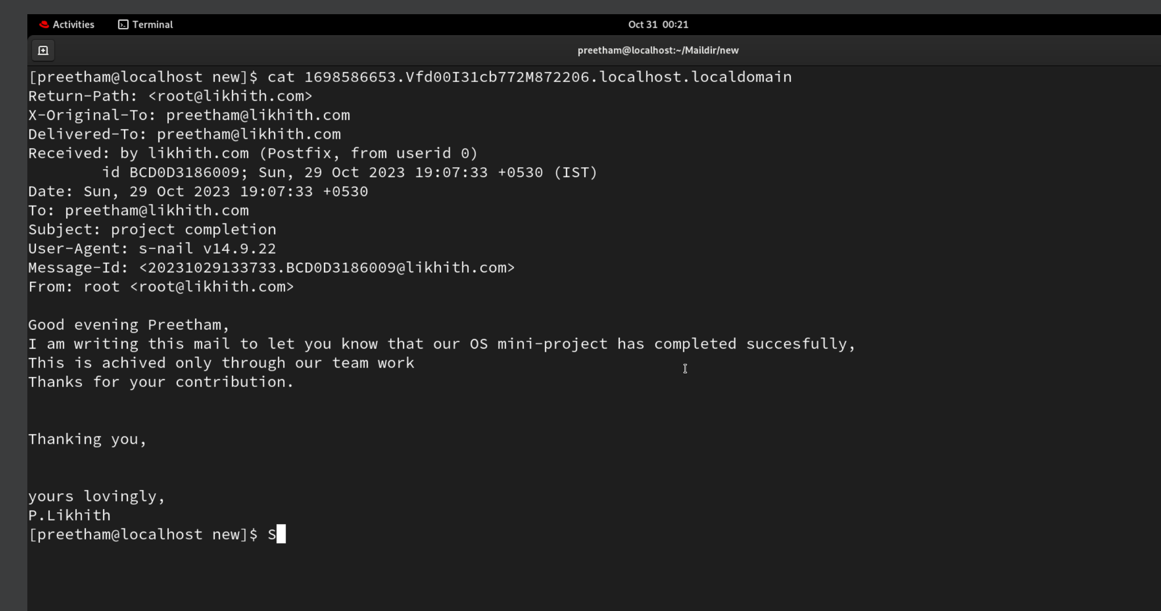

Slide 14



Team Presentation
P LIKHITH KUMAR REDDY
RA2211030010109
G VIGHNESHWAR REDDY
RA2211030010116
C PREETHAM RA2211030010117

Slide 15

GUIDE
DR THANGA REVATHI
ASST PROFESSOR

Slide 16

Thanks!

